Slide 1



Hiring Process

Slide 2

staffing needs and Preparation
Assess your department for staffing needs.
Staffing needs may be due to retirement, resignation, or termination.
You may see a need for a new position due to additional duties essential to your department.
Next Steps:
Create a position requisition and submit for approvals.
If all approvals are received, create the posting for the positions via PeopleAdmin.
Follow the hiring procedures in the upcoming slides.
Please keep in mind:
Adjunct, staff, faculty and student positions must be approved before posting.
Former employees must reapply to positions if there is a break in service.

Slide 3

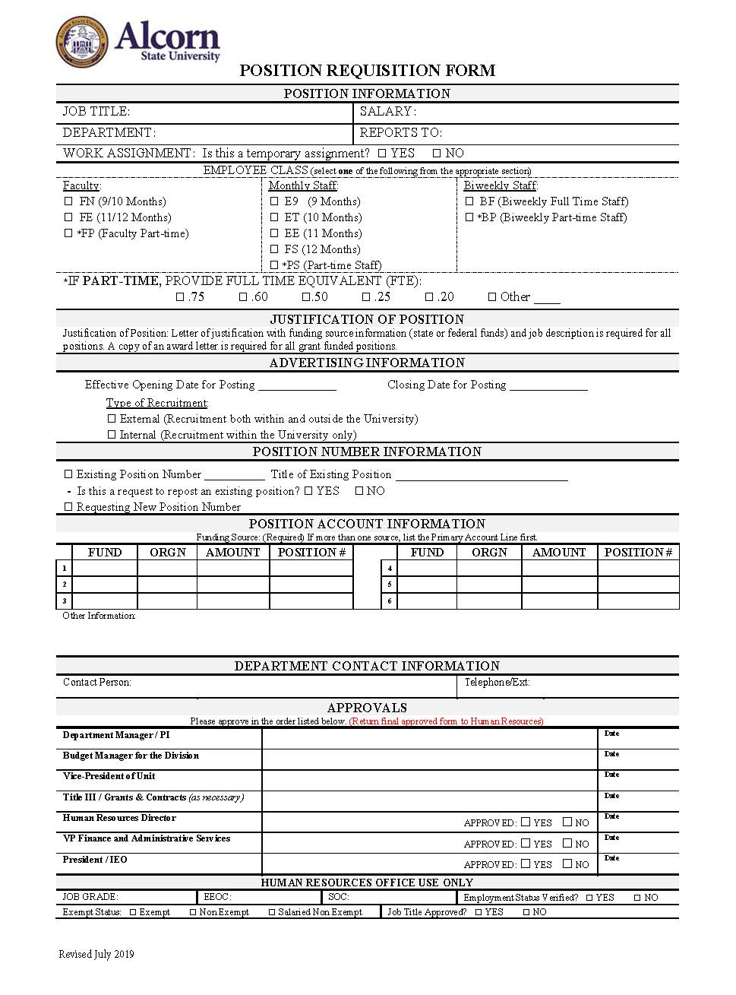
Position Requisition
The position requisition should be completed in the order of approvals.
If the position is not approved at any point during this process, it should be returned to the Department Manager requesting the position with a note why it is not approved.
Please note that the budget for Adjunct position requests are approved by the Office of the Provost.

Slide 4

STAFF HIRING
Complete the position requisition, attach letter of justification, and job description and submit in the order and approvals.
If approved, post position on PeopleAdmin website for candidates to apply.
Job advertisements must be posted for 10 business days to allow applicants the opportunity to apply.
Hold interviews and select a candidate
Write a letter of recommendation to hire candidate, attach their application, and the approved position requisition and submit to your immediate supervisor and the president for approval.
If approved, human resources will send an offer letter to the selected candidate.

Slide 5

Faculty Hiring
Complete the position requisition, attach letter of justification, and job description and submit in the order and approvals.
If approved, post position on PeopleAdmin website for candidates to apply.
Job advertisements must be posted for 10 business days to allow applicants the opportunity to apply.
Hold interviews and select a candidate
Write a letter of recommendation to hire candidate, attach their application, and the approved position requisition and submit to your immediate supervisor/dean, the provost, and the president for approval.
If approved, human resources will send an offer letter to the selected candidate.

Slide 6

Adjunct Faculty hiring
Complete the position requisition, attach letter of justification, and job description and submit in the order and approvals.
If approved, post position on PeopleAdmin website for candidates to apply.
Job advertisements must be posted for 10 business days to allow applicants the opportunity to apply.
Hold interviews and select a candidate
Write a letter of recommendation to hire candidate, attach their application, and the approved position requisition and submit to your immediate supervisor/dean, the provost, and the president for approval.
If approved, human resources will send an offer letter to the selected candidate.

Slide 7

STUDENT HIRING
Hourly Paid
(Funded through Department Budget)
Complete and submit the student position requisition found on the Student Employment Center Web Page and submit to the sec@alcorn.edu.
Post the position on PeopleAdmin for students to apply online.
Host interviews, select student employee(s) (move them to finalist in PeopleAdmin), and create hiring proposal in PeopleAdmin.
Student Employment Center will send the offer letter to the candidate.
If the candidate accepts the offer, HRM contacts the new hire to complete student paperwork. (not required if they have paperwork on file)
HRM will notify the supervisor when the new hire has completed paperwork.
The supervisor will contact the student employee with date and time to report to work.

Slide 8
STUDENT HIRING
Federal Work Study
(Federal Funded Position through Financial Aid)
Financial Aid will assign students to departments.
Department supervisor or designee will complete the Federal Work Study Assignment Form along with the student and submit to the Student Employment Center and provide a copy to Financial Aid.
Approve student timesheets.

Slide 9


Available Resources from the main website: www.alcorn.edu select careers You will be able to view and use resources regarding: 1. Human Resources Management 2. Student Employment Center

Slide 10


Thank You
Questions:
Call: 601-877-6188
Email: hrm@alcorn.edu

